Slide 1
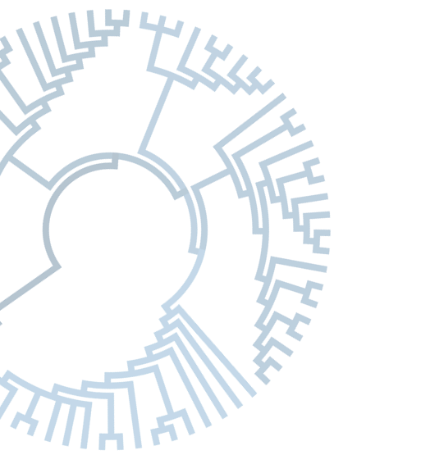
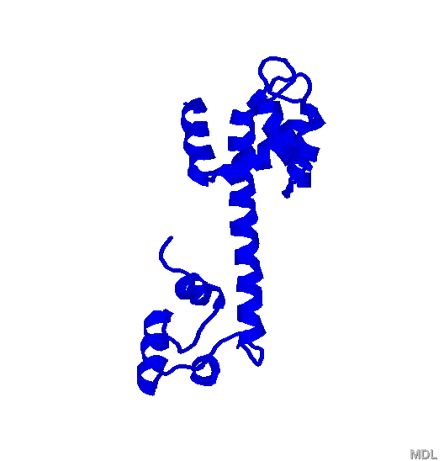
The neutral and nearly neutral theories of molecular evolution
Joseph P. Bielawski
Department of Biology
Department of Mathematic and Statistics
Institute of Comparative genomics
Dalhousie University, Halifax, Nova Scotia, Canada

Slide 2
Models of molecular evolution seek to explain the origin and maintenance of genetic variation
Notes:
Here, I am talking about a kind of model that is BOTH (1) A conceptual model, and at the same time (2) capable of making very explicit statements about the CAUSAL MECHANISMS responsible for the patterns of diversity the we see within species and between species.

Slide 3
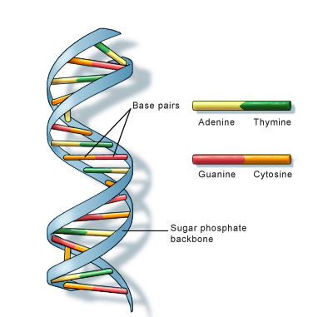
brief reminder of the fundamental evolutionary “forces”…
1. mutation
2. drift
3. natural selection

Slide 4
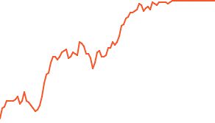
Key concepts:
mutation
fixation
substitution
f(C) = 1.0
fixation process
substitution:
the outcome of fixation process
substitution:
change in “state”
of the population
(A → C)
time
mutation
event
(A → C)
Notes:
Image information:
I created the images within PowerPoint.
The gene frequency trajectory was generated using the AlleleA1 simulation software.
These images are unpublished.

Slide 5
Mutations can be fixed or lost
mutation fixed in population
mutation lost from population
f = 1.0
f = 0.0
time
time

Slide 6
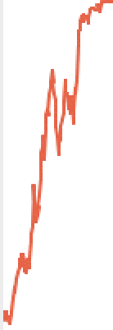
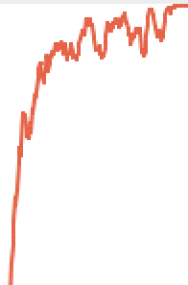
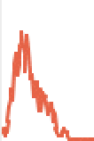
time
1.0
allele frequency
A
C
G
0
T
A➔C
C➔G
A
G
DNA state in process of gene-sequence evolution
From macroevolution view: substitutions “look like” instantaneous changes in state

Slide 7
Models of molecular evolution seek to explain the origin and maintenance of genetic variation
Notes:
Here, I am talking about a kind of model that is BOTH (1) A conceptual model, and at the same time (2) capable of making very explicit statements about the CAUSAL MECHANISMS responsible for the patterns of diversity the we see within species and between species.

Slide 8
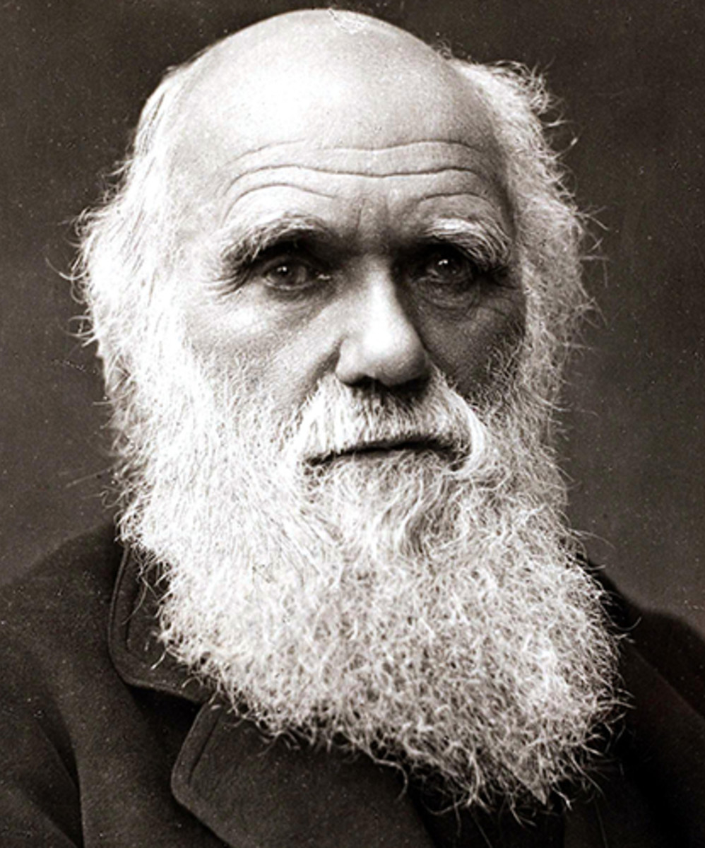
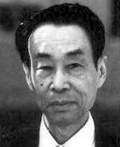

Conceptual models that explain genetic variation:
1. Neo-Darwinism
2. Neutral Theory
3. Nearly Neutral
natural selection dominates
genetic drift dominates
drift and selection interact
Notes:
The term "Neo-Darwinism" marks the combination of natural selection and genetics, as has been variously modified since it was first proposed.
Darwinism: 1859
Neo-Darwinsim: early 1900’s
Neutral theory: 1968 (King and Jukes, independently, 1969)
Otha… 1970s, Then updates in the 1990

Slide 9
Conceptual models that explain genetic variation:
1. Neo-Darwinism
2. Neutral Theory
3. Nearly Neutral
beneficial
beneficial
range of beneficial
neutral
neutral
deleterious
deleterious
deleterious
neutral
range of deleterious
natural selection dominates
genetic drift dominates
drift and selection interact

Slide 10
Conceptual models that explain genetic variation:
1. Neo-Darwinism
2. Neutral Theory
3. Nearly Neutral
natural selection dominates
genetic drift dominates
drift and selection interact
Notes:
Darwin:
https://www.biography.com/scientist/charles-Darwin
Photo: Bob Thomas/Popperfoto via Getty Images/Getty Images
Kimura:
https://en.wikipedia.org/wiki/Motoo_Kimura
Ohta:
https://womenyoushouldknow.net/population-genetics-tomoko-ohta/

Slide 11
Neutral theory of molecular evolution (Kimura 1968)
k = rate of nucleotide substitution [at mutation-drift equilibrium]
k = new mutations × probability of fixation
the number of new mutations arising in a diploid population
v
the fixation probability of a new mutant by drift
v
the substitution (fixation) rate, k
v
the elegant simplicity of neutral theory:
Notes:
MU = PER-INDIVIDUAL mutation rate

Slide 12
Why is the equilibrium substitution rate k = μ?
In words …
Small populations: lower number of new mutants each generation, but each has a higher probability of fixation
Large populations: higher number of new mutants each generation but probability of fixation is lower

Slide 13
1 2 3 k=3
N = small
1
Allele frequency
0
1 2 3 k=3
N = large
1
Allele frequency
0
mutation event
Notes:
the rate at which fixed differences accumulate between divergent populations is predicted to be equal to the PER-INDIVIDUAL mutation rate, independent of population size. When the proportion of mutations that are neutral is constant, so is the divergence rate between populations. This provides a rationale for the molecular clock - which predated neutral theory.

Slide 14
Neutral Theory: precise expectations when mutation & drift are at equilibrium
evolutionary rate is independent of population size
constant neutral rate : “molecular clock”
evolutionary rate is inverse of functional constraint

Slide 15
Distribution of fitness effects (DFE) of mutations according to Kimura’s Neutral Theory
lethal & strongly deleterious mutations:
rapidly removed by natural selection
never observed in natural populations
Kimura ignores them
neutral mutations =
vast majority of:
polymorphism
species divergence
~
beneficial mutations:
very rare
Kimura ignores them
-10
s = 0
+10
selection coefficients (s) for new mutations
Notes:
Potential scale is from + to – infinity
Often rescales + to – 1.0
Here, scaled from + to – 10 to make the figure easier to discuss.

Slide 16
Distribution of fitness effects (DFE) of mutations according to Kimura’s Neutral Theory
lethal & strongly deleterious mutations:
rapidly removed by natural selection
never observed in natural populations
Kimura ignores them
neutral mutations =
vast majority of:
polymorphism
species divergence
~
beneficial mutations:
very rare
Kimura ignores them
-10
s = 0
+10
selection coefficients (s) for new mutations

Slide 17
Neutral Theory: precise expectations when mutation & drift are at equilibrium
evolutionary rate is independent of population size
constant neutral rate : “molecular clock”
evolutionary rate is inverse of functional constraint (ignore beneficial mutations)

Slide 18
Distribution of fitness effects (DFE) according to Kimura’s Neutral Theory
lethal & strongly deleterious mutations:
rapidly removed by natural selection
never observed in natural populations
Kimura ignores them
The ratio of these determines
the rate of evolution
neutral mutations =
vast majority of:
polymorphism
species divergence
~
beneficial mutations:
very rare
Kimura ignores them
-10
s = 0
+10
selection coefficients (s) for new mutations
Notes:
NEGATIVE SELECTION DETERMINES THE RATE OF EVOLUTION

Slide 19
Distribution of fitness effects (DFE) according to Kimura’s Neutral Theory
lethal & strongly deleterious mutations:
rapidly removed by natural selection
never observed in natural populations
Kimura ignores them
The ratio of these determines
the rate of evolution
neutral mutations =
vast majority of:
polymorphism
species divergence
Lower-rate gene:
more sites functional
more mutations removed by selection

Slide 20
Distribution of fitness effects (DFE) according to Kimura’s Neutral Theory
lethal & strongly deleterious mutations:
rapidly removed by natural selection
never observed in natural populations
Kimura ignores them
The ratio of these determines
the rate of evolution
neutral mutations =
vast majority of:
polymorphism
species divergence
High-rate gene:
more neutral sites
more mutations fixed by drift
neutral theory predicts:
The evolutionary rate is inverse of functional constraint.

Slide 21
Conceptual models that explain genetic variation:
1. Neo-Darwinism
2. Neutral Theory
3. Nearly Neutral
natural selection dominates
genetic drift dominates
drift and selection interact
Notes:
Darwin:
https://www.biography.com/scientist/charles-Darwin
Photo: Bob Thomas/Popperfoto via Getty Images/Getty Images
Kimura:
https://en.wikipedia.org/wiki/Motoo_Kimura
Ohta:
https://womenyoushouldknow.net/population-genetics-tomoko-ohta/

Slide 22
DFE for Kimura’s Neutral Theory
evolution is modelled as an “all or nothing affair”
-10
s = 0
+10
DFE for Ohta’s Nearly-Neutral Theory
slightly deleterious mutations:
selection (-s) and genetic drift
slightly beneficial mutations:
selection (+s) and genetic drift
evolution is modelled as an interaction between genetic drift and natural selection
-10
s = 0
+10
selection coefficients (s) for new mutations

Slide 23
Distribution of fitness effects (DFE): broad importance to evolutionary biology
Evolutionary Importance:
mutations are ultimate source of variation
rate of evolution
species adaptation
mutational load (genome decay & reduced survival)
Inference DFEs:
longstanding goal
hard to estimate
much variation in observed DFEs
Notes:
(Note: Determine rate of evol AND patterns of divergence)

Slide 24
Distribution of fitness effects: non-synonymous mutations in viral PB2 gene
example: Tamuri et al. (2012) Genetics. 190:1101-1115.
features:
bimodal
deleterious: many
beneficial: fewer
nearly neutral: spectrum
fitness effects (s) =
-10
-2
0
+2
+10
deleterious
beneficial
nearly neutral mutations:
drift & selection interact
Notes:
Image information:
The histogram is PUBLISHED in Tamuri, A. U., dos Reis, M., & Goldstein, R. A. (2012). Estimating the distribution of selection coefficients from phylogenetic data using sitewise mutation-selection models. Genetics, 190(3), 1101-1115.
I modified and annotated the image in PowerPoint.
The modified version of the image is unpublished.

Slide 25
Distribution of fitness effects: generalized compilation of inferences
Remember this shape for later.
~
features:
bimodal
deleterious: many
beneficial: fewer with exponential character
nearly neutral: spectrum
fitness effects (s) =
-10
-2
0
2
+10
deleterious
beneficial
nearly neutral mutations:
drift & selection interact

Slide 26
3. Nearly Neutral
beneficial
+s > 10N
“neutral zone”
-s < 10N
deleterious
-1/2N < s < +1/2N
neutrality:
now depends on population size (N)
drift and selection interact
Notes:
DFEs: Note that some estimates put the fraction of neutral and nearly neutral mutations very high for some protein coding genes

Slide 27
3. Nearly Neutral
Ohta extends the selection and neutral models
Ohta adds evolution of “nearly neutral” mutations:
small populations:
nearly neutral mutations are “effectively neutral”
nearly neutral mutations evolve by genetic drift
large populations:
deleterious: mostly eliminated by natural selection
beneficial: fixed more frequently than by drift (but fixation is not certain)
drift and selection interact
now… molecular clock unlikely (the rate of evolution is affected by changes in N)
Notes:
Image information:
Ohta photo: https://womenyoushouldknow.net/population-genetics-tomoko-ohta/

Slide 28
Selective implications of near neutrality
rate slows as population becomes adapted
population approaches an equilibrium
population reaches a state of “detailed balance”

Slide 29
concave (saturating) fitness curve
engineering perspective → natural populations
fitness
phenotypic trait

Slide 30
concave (saturating) fitness curve
fitness
phenotypic trait

Slide 31
concave (saturating) fitness curve
fitness
phenotypic trait

Slide 32
concave (saturating) fitness curve
In this setting …
fitness increases are finite
many ways to improve low fitness
fewer ways to improve upon higher fitness when close to optimum
fitness
← phenotype ←
larger fitness
effects
→ phenotype. →
smaller fitness
effects

Slide 33
Implications of nearly neutral theory
Implication 1:
fitness
Rate slows as population becomes adapted
selection dominates
selection less effective
selection interacts with drift
population size matters (drift stronger in smaller populations)
Notes:
RATE here is phenotypic evolution!
This is, possibly trivial, point in relation to the selective models (effect size selection >> effect size drift) that explain the origin and maintenance via ongoing environmental changes that drive CONSTANT (ON-GOING)evolution. (see this, as a contrast in part two when we look at the effects of freq dependent selection on the substation rate). … i.e., thei point is about EVOLUTION ON A FIXED LANDSCAPE.

Slide 34
Implications of nearly neutral theory
phenotypic steady state
Implication 2:
fitness
population approaches an equilibrium point
selection dominates
(up to this point)
mut & drift dominate
more ”ways” for mutation to decrease fitness
(mutation pressure)
Notes:
This is why some forms of Nearly-Neutral models are sometimes called “steady state models” or “balance mutation models”
Sella and Hirch 2005
Hartle and Taubes 1996
Razzeto-Barry et al. 2012

Slide 35
An now, an actual molecular evolutionary process…

Slide 36
example: epistasis and protein stability
phenotypic steady state
Global fitness
Stabilizing substitution
De-stabilizing substitution

Slide 37
Implications of nearly neutral theory
substitutions
equilibrium point: average affect on phenotype is balanced such that beneficial and deleterious substitutions of the same absolute effect have equal substitution rates
DFEs:
asymmetric around zero
can change with evolution
Implication 3:
evolutionary process reaches a state of “detailed balance”
mutations
0
Notes:
This is why some forms of Nearly-Neutral models are sometimes called “steady state models” or “balance mutation models”
Sella and Hirch 2005
Hartle and Taubes 1996
Razzeto-Barry et al. 2012
IMPORTANT LECTURE NOTES…
The NOTION of detailed balance here is important because of an historical miss-interpretation of Otha’s theory. Ohat showed that is large populations, large deleterious change are effectively prevented, but small deleterious fixations are not and should accumulate over time. This has been MISTAKENLY taken to mean that populations would degrade in fitness over time (See Sella and Hirsh 2005 Intro).
HOWEVER, Ohta’s theory IS ALSO CONSISTENT WITH large positive fixation events compensates for many small declines. AND, many small positive changes can compensate for many small declines in fitness (degree depending on the intensity of drift [via Ne])…
The point, HERE, is that a LONG-TERM STEADY-STATE is achieved at the level of substitutions where the fitness effects are BALANCED at the level of substitutions!
SIDE-NOTE about “entropic pull”. Given a certain stability, there are many more configurations where many sites contribute a little to stability than one or a few sites causes nearly all the stability. So “entropic pull” refers to the tendency of the system to move towards the more uniform distribution of stability affects. Evolution then becomes a “random walk” within this “subspace” of configurations determined by mutation-drift-selection equilibrium.
The evolutionary steady state balances between the evolutionary tendencies in finite populations to increase both fitness and entropy.
McCandlish et al 2016
The first factor is coevolution between sites as suggested by, e.g., Pollock et al. (2012). As long as the derived allele is resident at the focal site, it forms part of the genetic background for other substitutions, and this causes the population to tend to spend more time at genotypes where the derived allele is selectively favored. [ONLY because entropically the probability of moving into a low propensity state for the bath is so high]
>>>>???????>>>>>>>>
UNDER EPISTASIS: Fixation changes the distribution of fitness effects on MUTATIONS. This changes the space in which the “entropic pull” is operating. Depending on your definition of Stokes shift… On the notion of a site-specific stokes shifts. The propensity of an amino acid (marginal effect on amino acid frequency) can go up or down following a substitutions. The Stokes shift is described as the tendency for amino acid propensity of a resident amino acid to go up (related to entrenchment; where prob of subst goes down due to evol at other sites) as evolution occurs at other sites. So, we have demonstrated something that can be called the “ANTI-STOKES SHIFT”.
BUT… Goldstein and Pollock clearly think of the Stokes shift differently (based on direct communication, but they are not that clear about it in the original paper). Their view appears to be that the Stokes shift is mean to refer to the average effect on propensity at a site that arises in response to the changing space/configuration in which stability can come from small effects spread over many sites. It seems to be something like mutations get fixed that occasionally concentrate stability, and there is slow process of returning to more uniform part of sequence space leads to a net positive Stokes shift of the appropriate time-frame. (something like this… they seem to be saying something like there are two process operating at the same time; local detailed lance and full-sequences level effects of entropic pull)
NOTE: DFE at a site changes with each substitution at another site, but on average it hovers are something like this

Slide 38
The equilibrium phenotype is NOT the most fit type. (adaptation ≠ optimal “engineering” state)
The “marginal stability” of natural proteins is NOT an adaptive state
Natural selection plays important role to prevent “mutational meltdown”.

Slide 39
Summary

Slide 40
Neo-Darwinism:
almost everything is adaptive (too strong)
evolution “seeks optimality” (promotes an engineering perspective)
remains THE evolutionary mechanism for origin of adaptations
Notes:
Darwin:
https://www.biography.com/scientist/charles-Darwin
Photo: Bob Thomas/Popperfoto via Getty Images/Getty Images
Kimura:
https://en.wikipedia.org/wiki/Motoo_Kimura
Ohta:
https://womenyoushouldknow.net/population-genetics-tomoko-ohta/

Slide 41
Neo-Darwinism:
almost everything is adaptive (too strong)
evolution “seeks optimality” (promotes an engineering perspective)
remains THE evolutionary mechanism for origin of adaptations
Neutral theory:
elegant simplicity
assumes simplistic DFE
predictions are correct for effectively neutral mutations
many predictions serve as “principles of evolution” (despite simplistic DFE)
Notes:
Darwin:
https://www.biography.com/scientist/charles-Darwin
Photo: Bob Thomas/Popperfoto via Getty Images/Getty Images
Kimura:
https://en.wikipedia.org/wiki/Motoo_Kimura
Ohta:
https://womenyoushouldknow.net/population-genetics-tomoko-ohta/

Slide 42
Neo-Darwinism:
almost everything is adaptive (too strong)
evolution “seeks optimality” (promotes an engineering perspective)
remains THE evolutionary mechanism for origin of adaptations
Neutral theory:
elegant simplicity
assumes simplistic DFE
predictions are correct for effectively neutral mutations
many predictions serve as “principles of evolution”
Nearly-neutral theory:
predicts more complex evolutionary dynamics
depends on populations size (unlike neutral theory)
some predictions closer to natural populations that neutral theory
predicts equilibrium where phenotype is not necessarily optimal
natural selection acts to balance “mutational load” on fitness (maintenance)
Notes:
Darwin:
https://www.biography.com/scientist/charles-Darwin
Photo: Bob Thomas/Popperfoto via Getty Images/Getty Images
Kimura:
https://en.wikipedia.org/wiki/Motoo_Kimura
Ohta:
https://womenyoushouldknow.net/population-genetics-tomoko-ohta/

Slide 43
An index of the intensity of natural selection for proteins

Slide 44
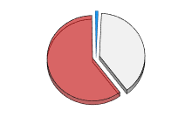
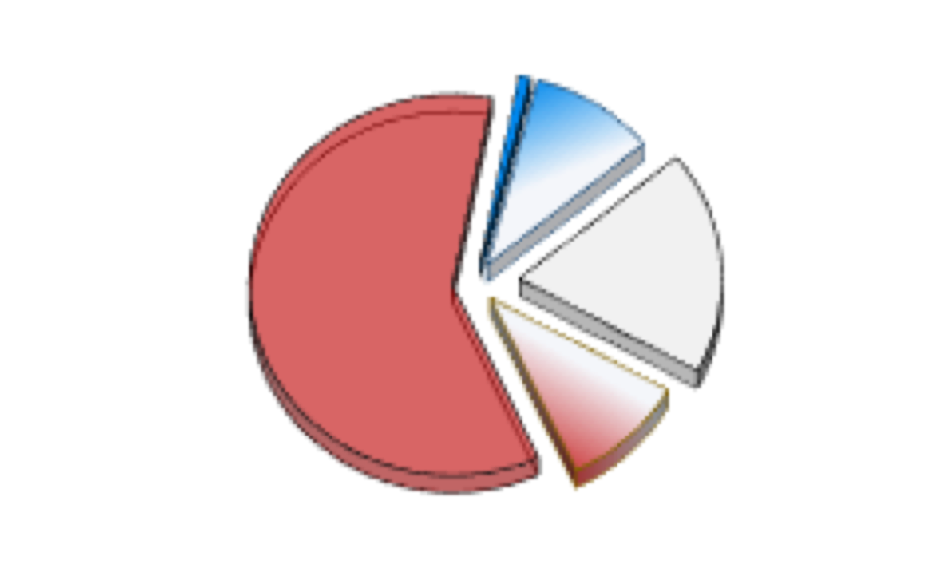
Neutral and Nearly-neutral theory
Evolutionary rate depends on intensity of selection
Neutral theory:
independent of N
Nearly-neutral theory:
depends on N
Let’s apply these ideas to individual sites…

Slide 45
1.) selectively constrained:
neutral space < 100%
rate < strictly neutral
2.) strictly neutral:
100% neutral space
rate = neutral rate
3.) adaptive evolution:
large adaptive space
rate > neutral rate (?)
Question:
What is the neutral rate?
conserved sites: slower than neutral?
fast sites: neutral? or faster than neutral?

Slide 46
Proteins have a “built in ruler” for their own neutral rate of molecular evolution!

Slide 47
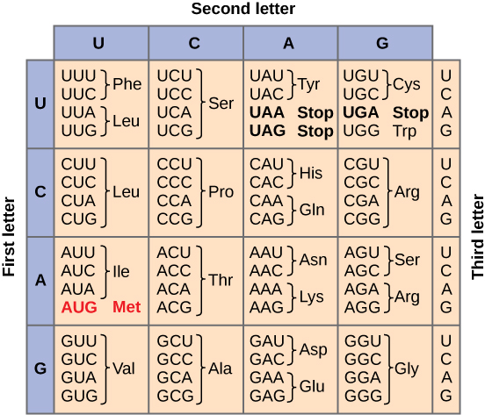
Genetic code
synonymous (S): no change to protein
no effect on protein
selectively neutral
rate = neutral rate (w.r.t. protein evolution)
non-synonymous (N): changes the amino acid composition of protein
changes AA of protein
deleterious, or neutral, or positive
rate depends on intensity of selection
all possible mutations → two types

Slide 48
“built in ruler” = synonymous substitution rate
The rate at which that proteins would have evolved if it had been 100% free from selection (at the protein level).
The “neutral rate” for this protein (K_{S})

Slide 49
Genetic code
synonymous (S): no change to protein
no effect on protein
selectively neutral
rate = neutral rate
neutral rate = K_{S}
all possible mutations → two types

Slide 50
Neutral Theory:
The rate of evolution for synonymous sites
new synonymous (S) mutations
max
“neutral space”
(100%)
K_{S} = HIGH

Slide 51
Genetic code
synonymous (S): no change to protein
no effect on protein
selectively neutral
rate = neutral rate
neutral rate = K_{S}
non-synonymous (N): changes the amino acid composition of protein
changes AA of protein
deleterious, or neutral, or positive
rate depends on intensity of selection
purifying selection: K_{N} < K_{S}
all possible mutations → two types

Slide 52
Neutral Theory:
The rate of evolution for synonymous sites
Neutral Theory:
The rate of evolution for synonymous sites
new synonymous (S) mutations
new non-synonymous (N) mutations
max
“neutral space”
small
“neutral space”
(100%)
( < 100%)
K_{S} = HIGH
K _{N}= LOW

Slide 53
Kimura (1983) : the rate ratio is an index of selection intensity
NOTATION:
rate ratio mode example
K_{S} = d_{S}: number of synonymous substitutions per synonymous site
K_{N} = d_{N}: number of nonsynonymous substitutions per nonsynonymous site
K_{N}/K_{S} < 1 | purifying (negative) selection | histones
K_{N}/K_{S} =1 | neutral evolution | Pseudogenes
K_{N}/K_{S} > 1 | diversifying selection | MHC, Lysin
This is the “omega ratio” in codon models
Notes:
SOME IMPORTANT LECT NOTES…
NOTE: When we started we obtained K by a simple “counting”. There are indeed methods for actual estimation of these RATES by counting (and they are called counting methods). The estimates obtained by using ML are superior to the counting methods. I have covered this in previous workshops, but I decided to spare you those details this year.
You you need to know is that we (1) desire an estimate of the ratio of two RATES, (2) the rates is ….[above] , and (3) we can estimate this rate ratio from a dataset via ML.

Slide 54
1.) selectively constrained:
K_{N} / K_{S} < 1
2.) strictly neutral:
K_{N} / K_{S} = 1
3.) adaptive evolution:
K_{N} / K_{S} > 1
constrained sites: K_{N} / K_{S} < 1
fast sites: K_{N} / K_{S} = 1 ―or ― K_{N} / K_{S} > 1

Slide 57
NOTE: This is Figure from a submitted manuscript that uses the same 3D protein images as used in slide 41

Slide 58
metaphor: the width of the selective sieve (the rate of evolution is inversely related to intensity of selection)
new synonymous (S) mutations
new non-synonymous (N) mutations
synonymous substitution rate: FAST
(many get fixed
because they are neutral)
non-synonymous substitution rate: SLOW
(very few get fixed because
they are mostly deleterious)
K_{S} = HIGH
K_{N} = LOW

